Slide 1

WAY TO ENTERPRISE
AWS
VTI ACADEMY
Author: duy.nguyenngoc1@vti.com.vn

Slide 2
Agenda
Monolith & Microservices Architecture
Docker & Kubernetes
CICD
Copyright © VTI Academy All Rights Reserved

Slide 3
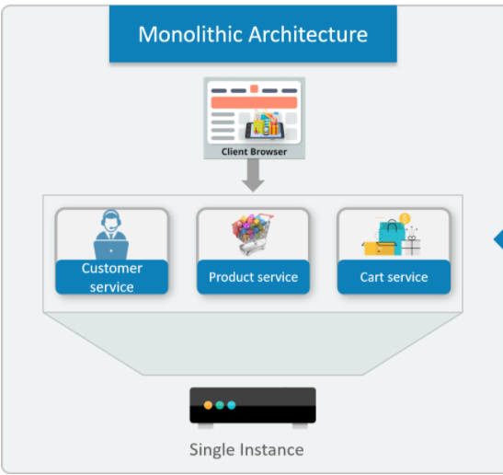
Monolith Architecture
All modules (view, business, database, ...) are grouped into one large project 🡺 difficult to upgrade
Advantages
  Simple architecture, easy to code
  Suitable for small application & medium applications, less upgraded application
Disadvantages
  Release every few months
  Team size: large
  Debugging is easy

Slide 4
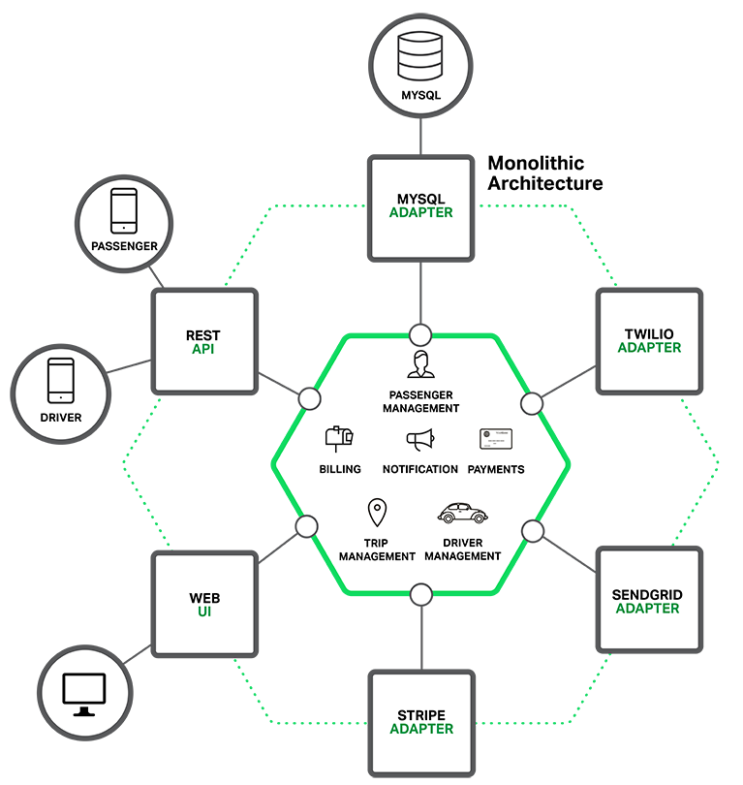
Monolith Architecture
  Difficulty applying new technologies
  When you want to upgrade a certain module, you have to redeploy whole project 🡺 the user will have to wait for whole project to deploy
  If one module fails, it can bring down the entire system.

Slide 5
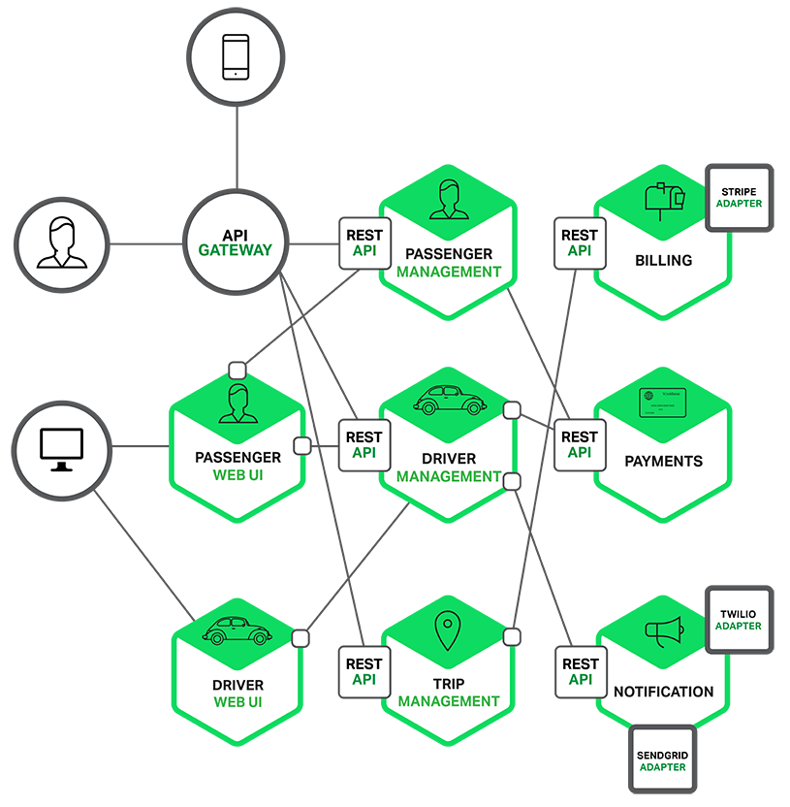
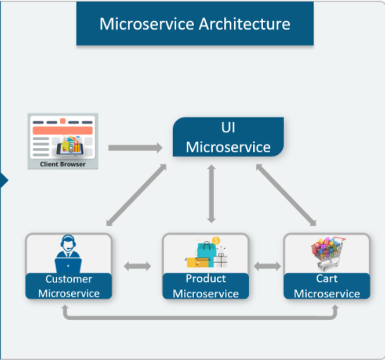
Microservices Architecture
Split a project into small services (microservices)
Services communicate with each other via HTTP (REST) or Message Queue

Slide 6
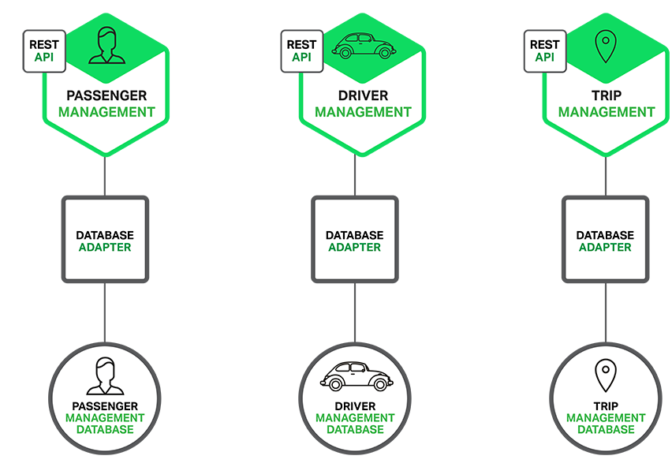
Microservices Architecture
Each 1 service can
  Use a different database
  Place on a different server
  Use different programming languages
Advantages
  Quick Release
  Team size: from 2 to 5 people
  Debugging is difficult

Slide 7
Microservices Architecture
  Easy to apply new technologies, new programming languages, database, ... For new services
  When you want to upgrade a certain module, you need to redeploy only that module
  If a service fails, the rest of the project will still work normally
Disadvantages
  Projects communicate over the network 🡺 the speed may not be as high as monolith
  Each module has to deal with security issues, transactions, connection errors, log files management, ...
  Monitoring and managing these services will be more complicated

Slide 8
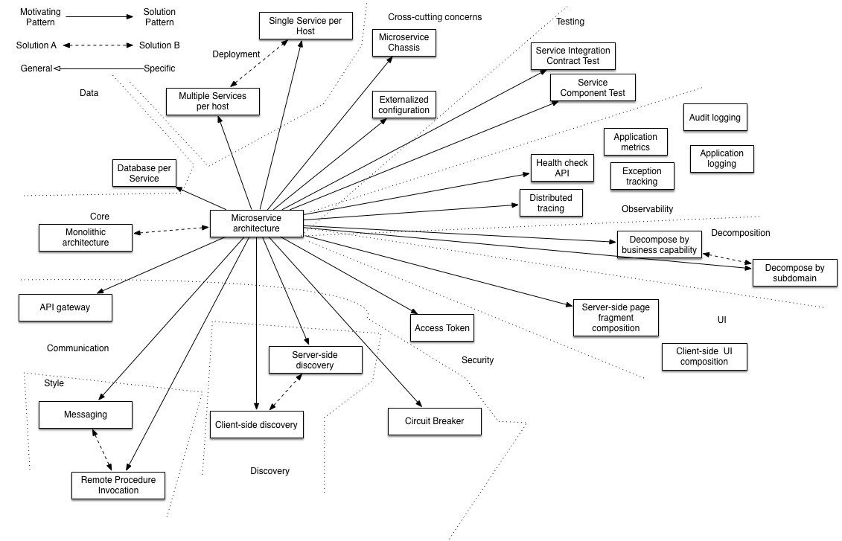
Microservices Architecture
Features
https://microservices.io/patterns/microservices.html

Slide 9
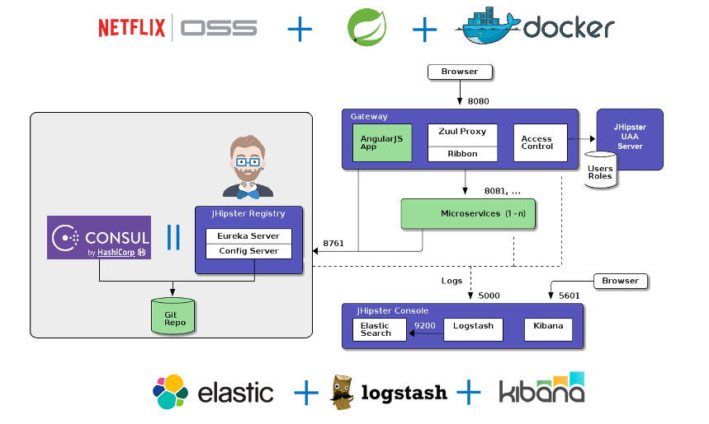
Microservices Architecture
Demo
  https://drive.google.com/open?id=16PmWbMfLdJsAGVrA9oxHkquKNvqxInBI
https://www.jhipster.tech/microservices-architecture/

Slide 10
Monolith & Microservices
References
  https://microservices.io/patterns/microservices.html
  https://www.springboottutorial.com/creating-microservices-with-spring-boot-part-1-getting-started
  https://www.edureka.co/blog/what-is-microservices/
  https://www.javatpoint.com/microservices

Slide 11
Assignment
  Self-practice

Slide 12
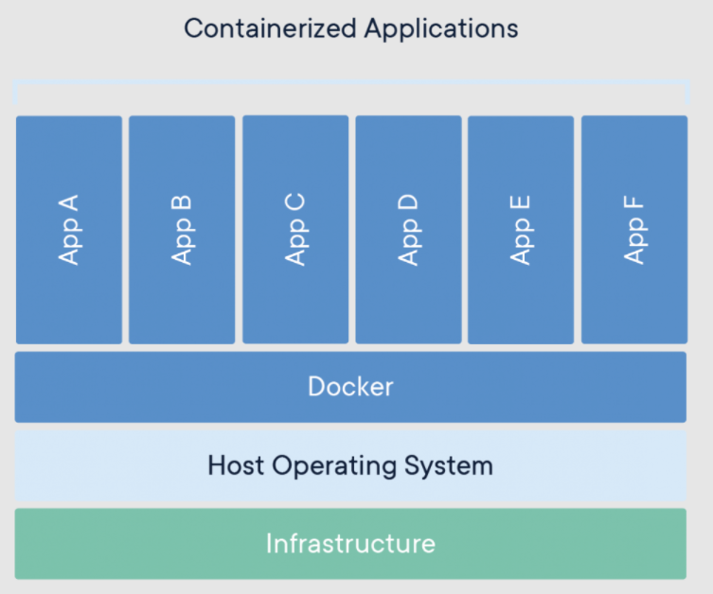
Docker
Allows you to package your application (Code, Libraries, Dependencies, runtime, tools required, other Settings, ...) to container and run separately on any OS
Apps run the same, regardless of where they’re run
  Any machine
  No compatibility issues
  Predictable behavior
  Less work
  Easier to maintain and deploy
  Works with any language, any OS, any technology

Slide 13
Docker
Components
  Infrastructure: hardware (laptop, server, virtual machine (VirtualBox, Hyper-V, VMware, QEMU, ..)
  Host Operating System: OS (CPU, Ram, Disk, Network, ...)
  Apps: Database (MySQL, SQL Server, ...), Web Server (Tomcat, Nginx, Caddy, ...), Caching (Redis/Memcached), Framework (Spring-Boot, Django, Rails, NodeJS, ...)
  Docker: Engine, Image, Container, Docker Compose, Registry
Tutorial: https://www.youtube.com/playlist?list=PLwJr0JSP7i8At14UIC-JR4r73G4hQ1CXO

Slide 14
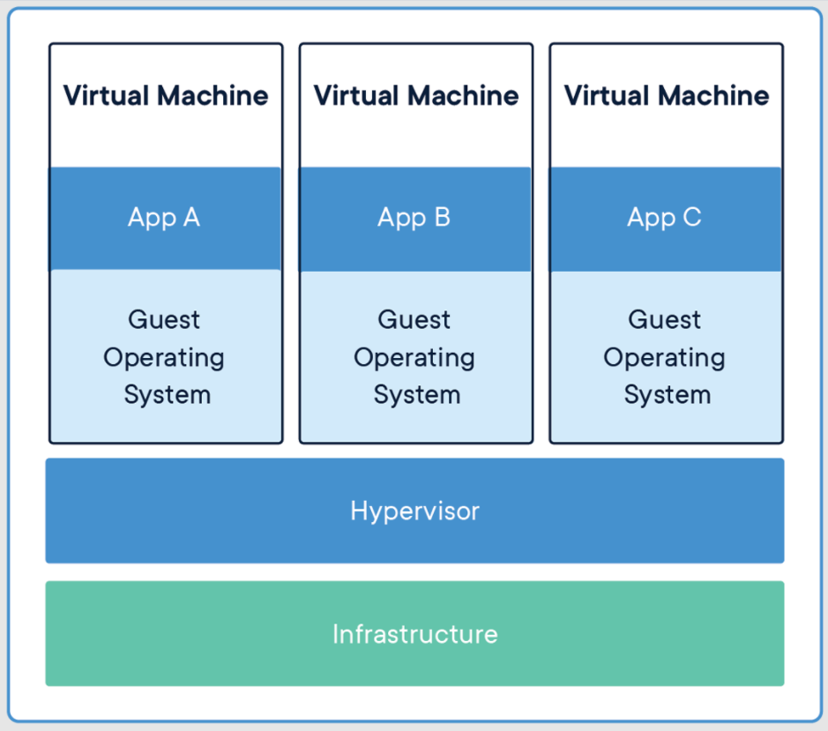
Docker
Compare Virtual Machine & Docker
  Virtual Machine
    Working similar to many separate computers on the same hardware
    Each VMs include Application, Libraries, the copy of OS, hardware, ...
    Disadvantages: VM takes a lot of host resources
    Advantages: Good security, easy to setup
Virtual Machine

Slide 15
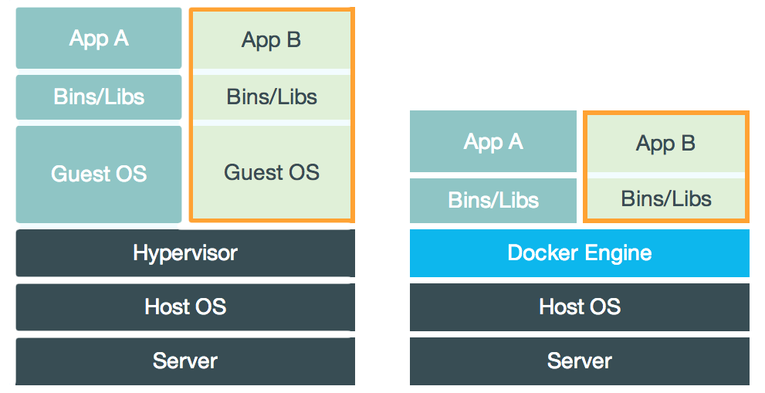
Docker
  Docker
    Shared components: Libraries, OS, hardware, ...
    Shared components are read-only 🡺 Docker are lightweight
    Advantages: reduce the size of snapshots
    Disadvantages: difficult for newbies
Docker
Comparing

Slide 16
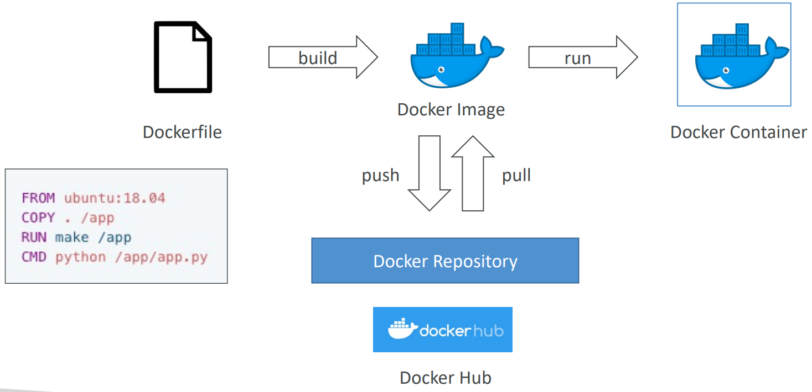
Docker
Flow

Slide 17
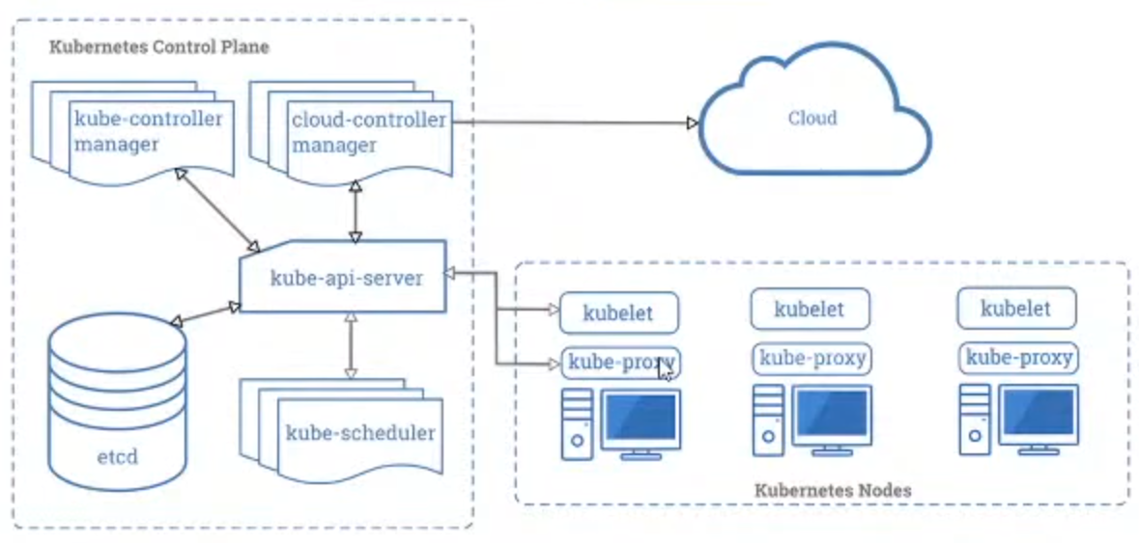
Kubernetes
Kubernetes (k8s) allow manage, deploy, scale container-based applications across multiple hosts
Similar to Docker-swarm
Features: Autoscaling, Load Balancing, HealthCheck, Autorestart, ...
Components: Cluster, Node, Pod, Service, ReplicaSet, StatfulSet, ConfigMap & Secrets, ...
Tutorial: https://www.youtube.com/playlist?list=PLwJr0JSP7i8D-QS50lYsXpAg-jYoqxMVy

Slide 18
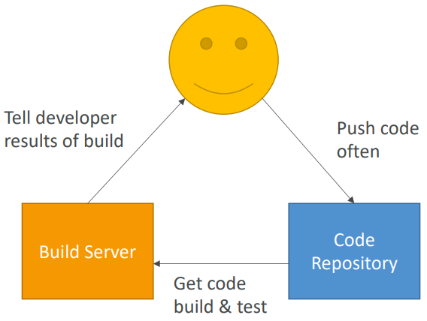
CICD
Developers push the code to a code repository often (GitHub, CodeCommit, Bitbucket, …)
A testing / build server checks the code as soon as it’s pushed (CodeBuild / Jenkins CI / etc…)
The developer gets feedback about the tests and checks that have passed / failed 🡺 You should use CICD tools

Slide 19
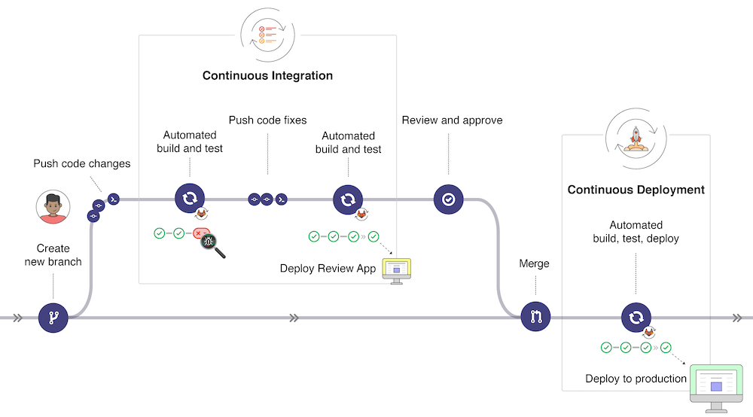
CICD
CICD Flow

Slide 20
Q & A
Copyright © VTI Academy All Rights Reserved

